Slide 1

INTERNSHIP 2024 SOLID PROPULSION
WEEK 11 PROGRESS REPORT

Slide 2
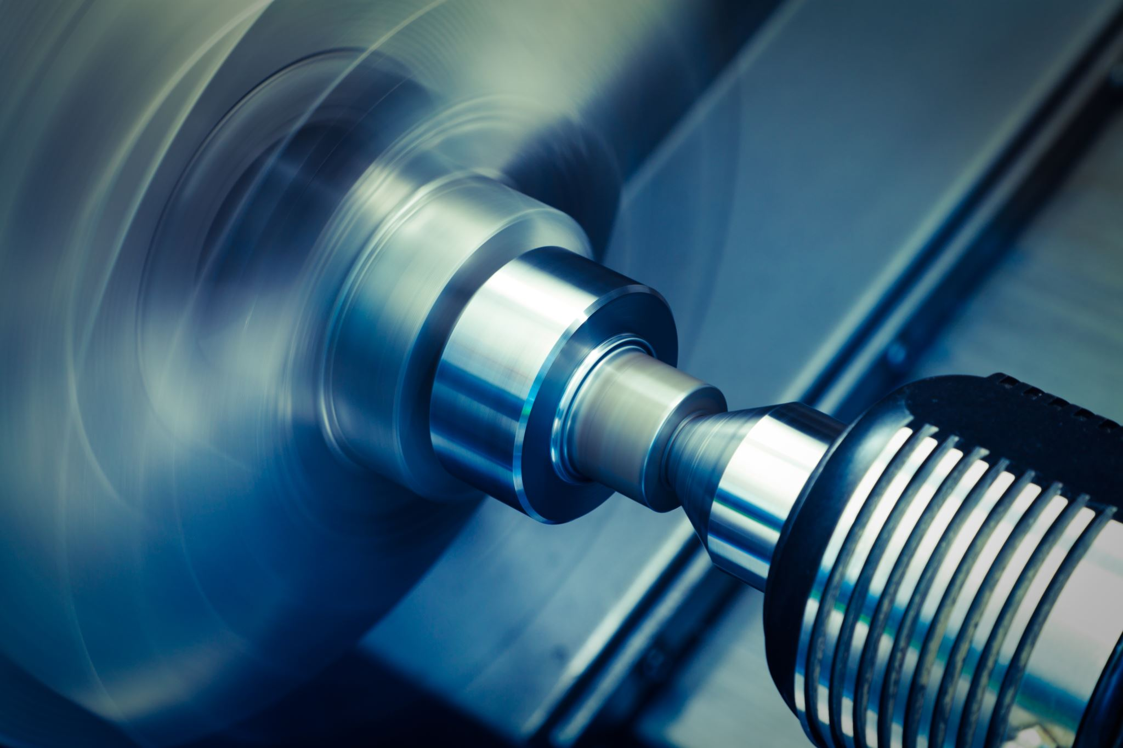
SIXTH WEEK’S OBJECTIVES
Boring of motor casing.#131
Machining of a nozzle#105
Cooking grains.#83
Purchase of Materials #115
Making ignitors.#59
Machining of the casting Core rods#140

Slide 3
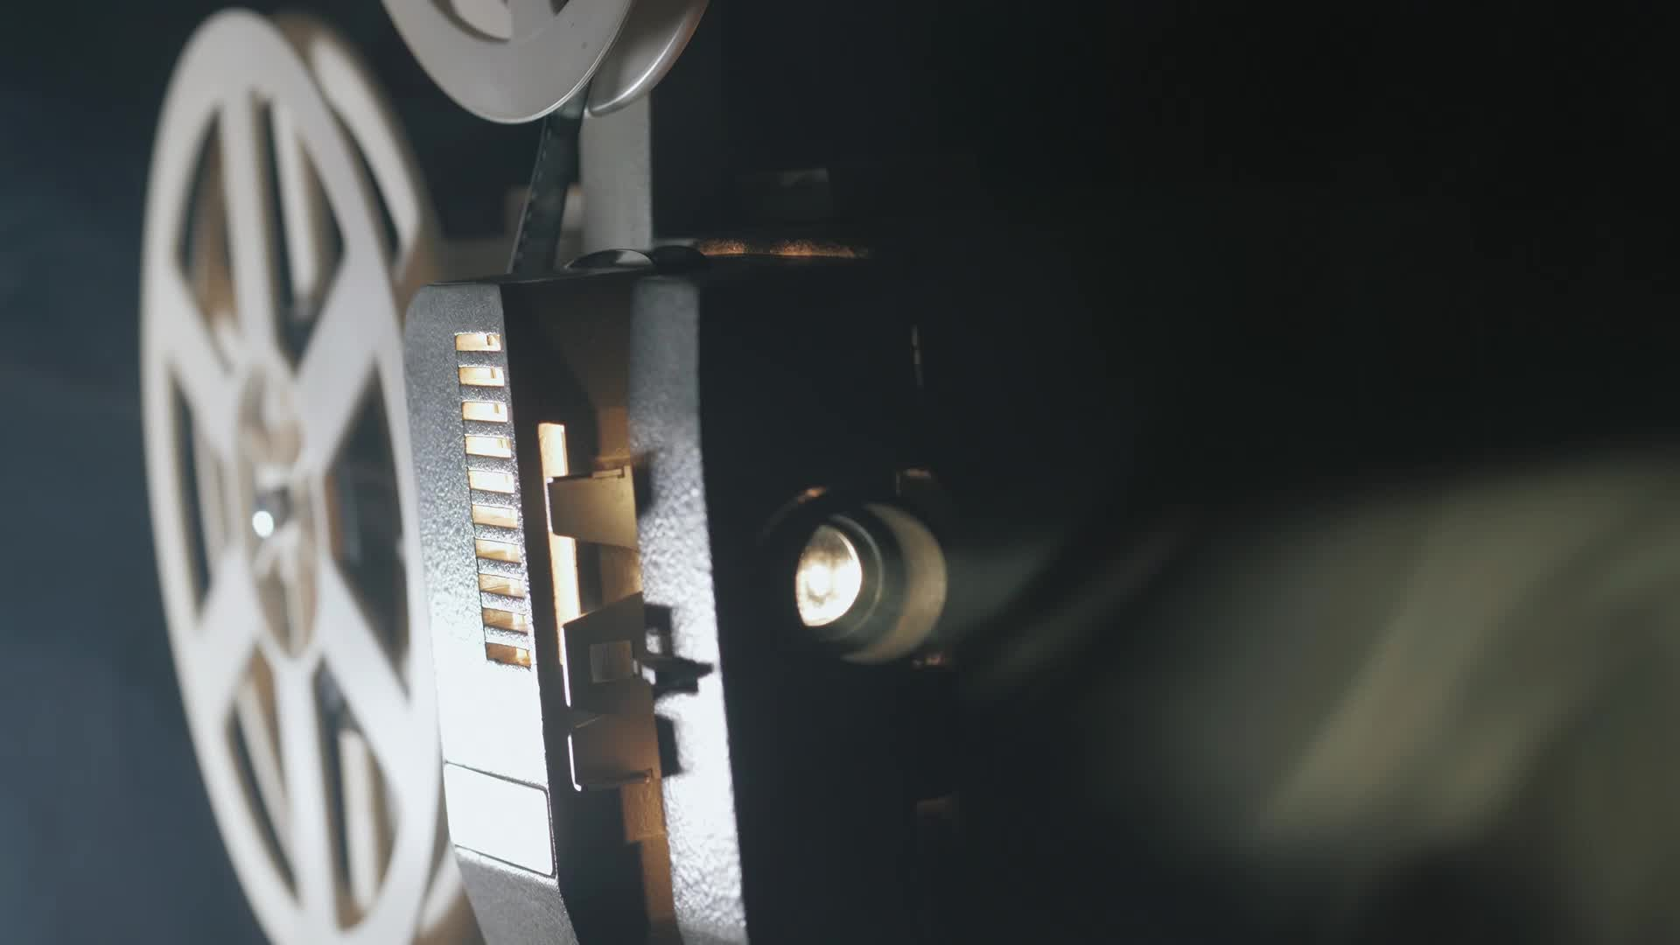
TASKS COMPLETED
1. Boring of motor casing.
2. Machining of a nozzle
3. Cooking grains.
4. Purchase of Materials
5. Making ignitors.
6. Machining of the casting Core rods.

Slide 4
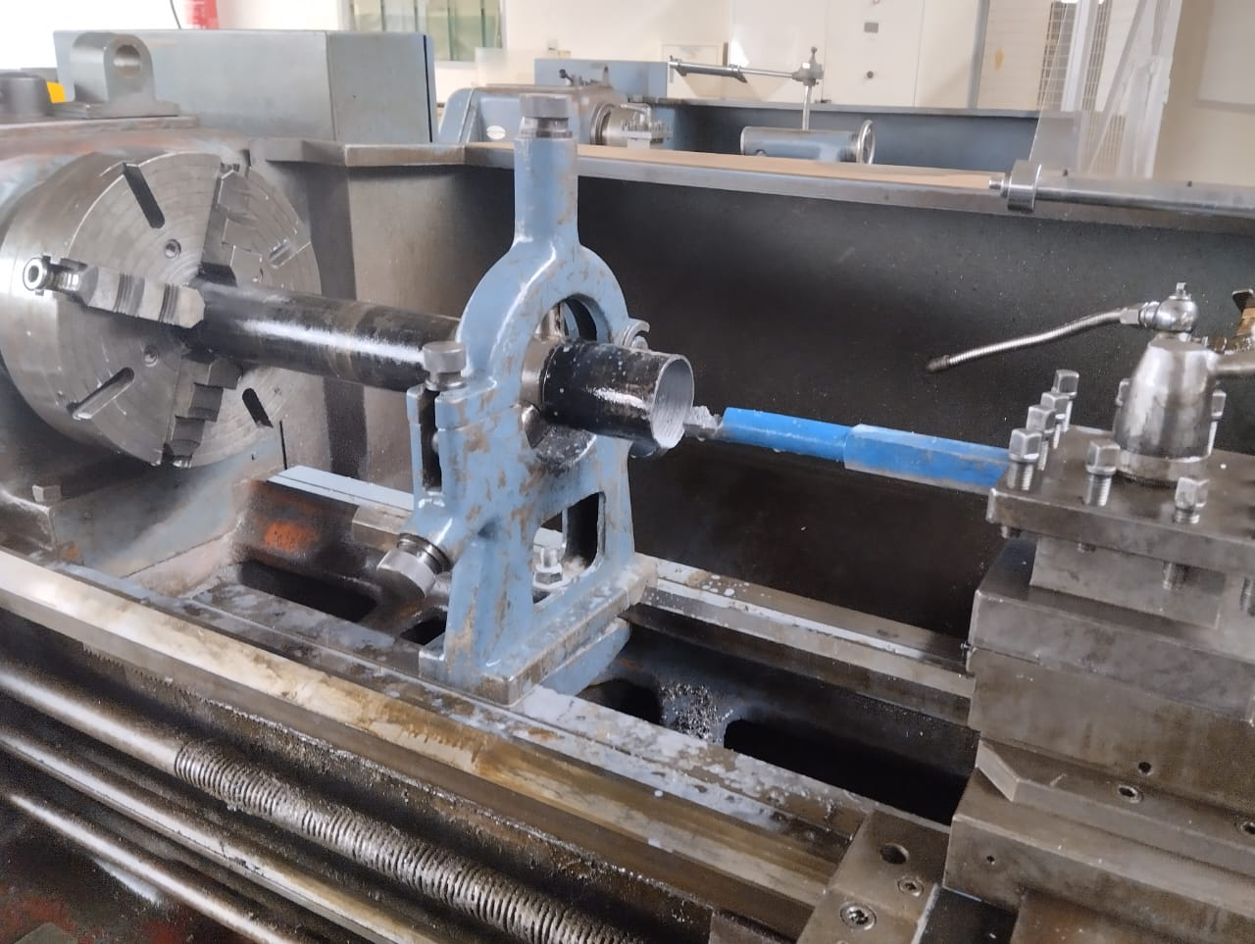
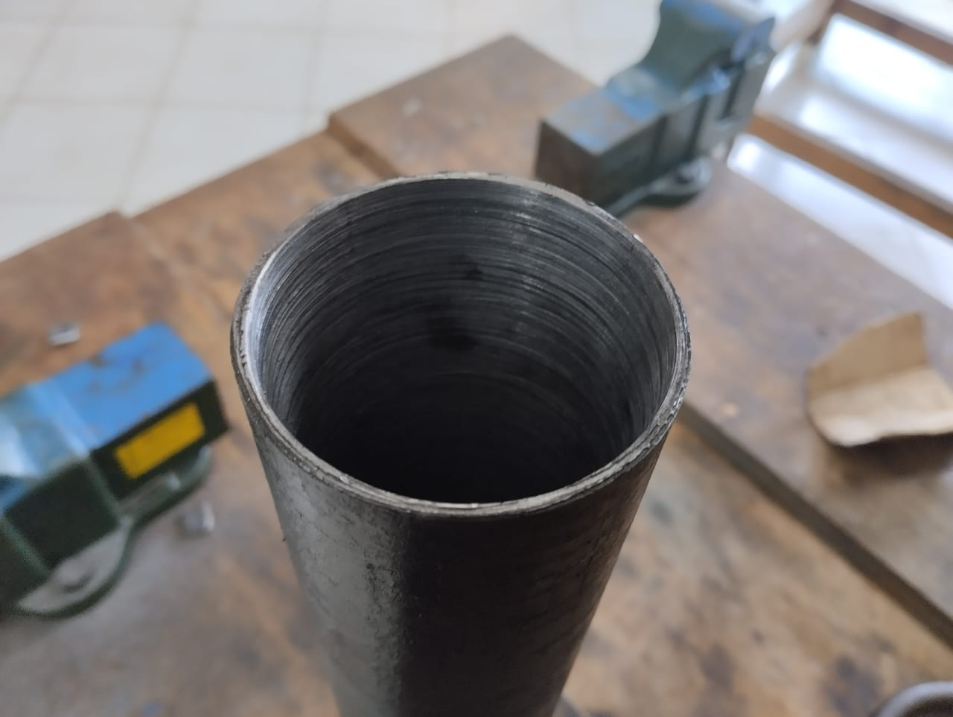
Boring of motor casing.#131
One Motor casing bored
T= 2.5mm
Dout = 73mm
Din = 68mm
L = 500mm

Slide 5
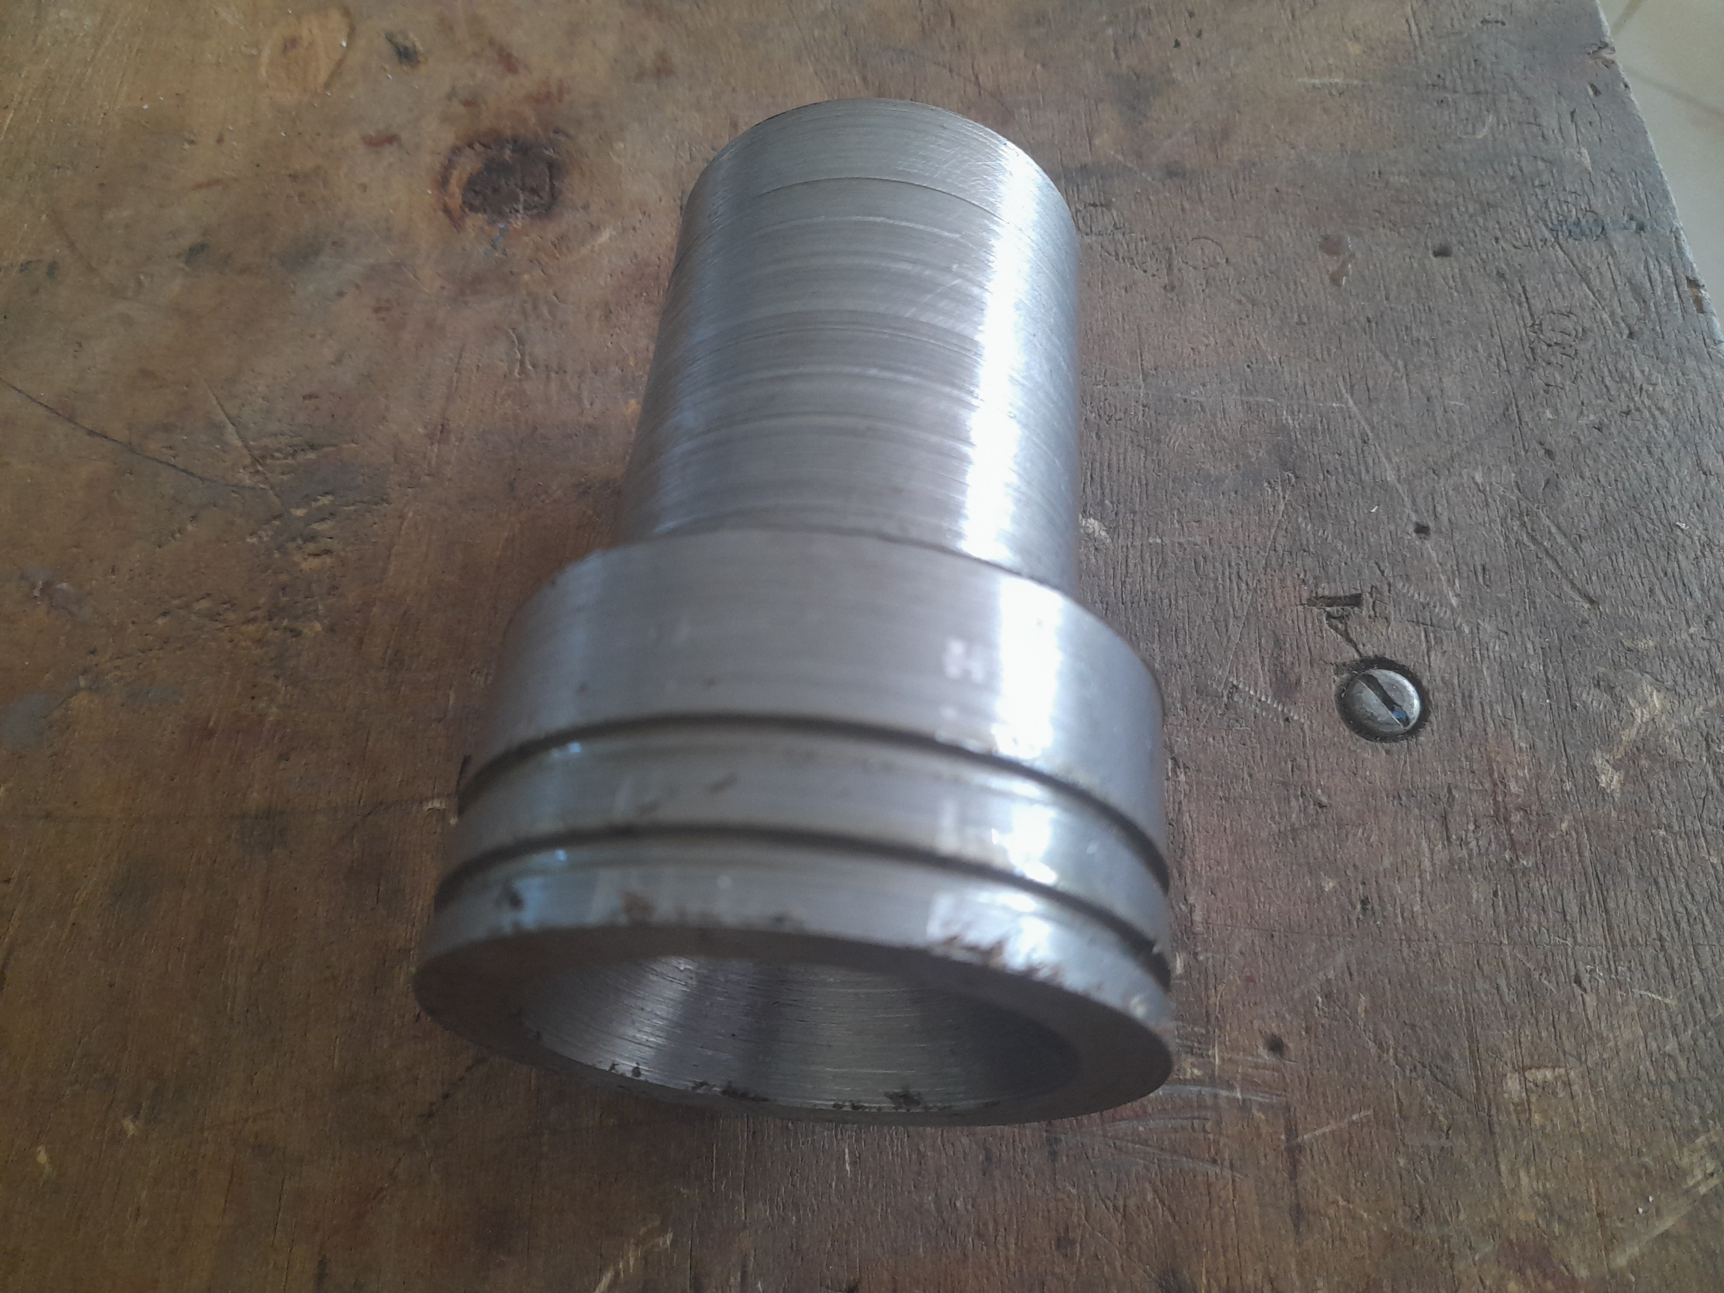
Machining of a nozzle#105
One more nozzle
was machined

Slide 6
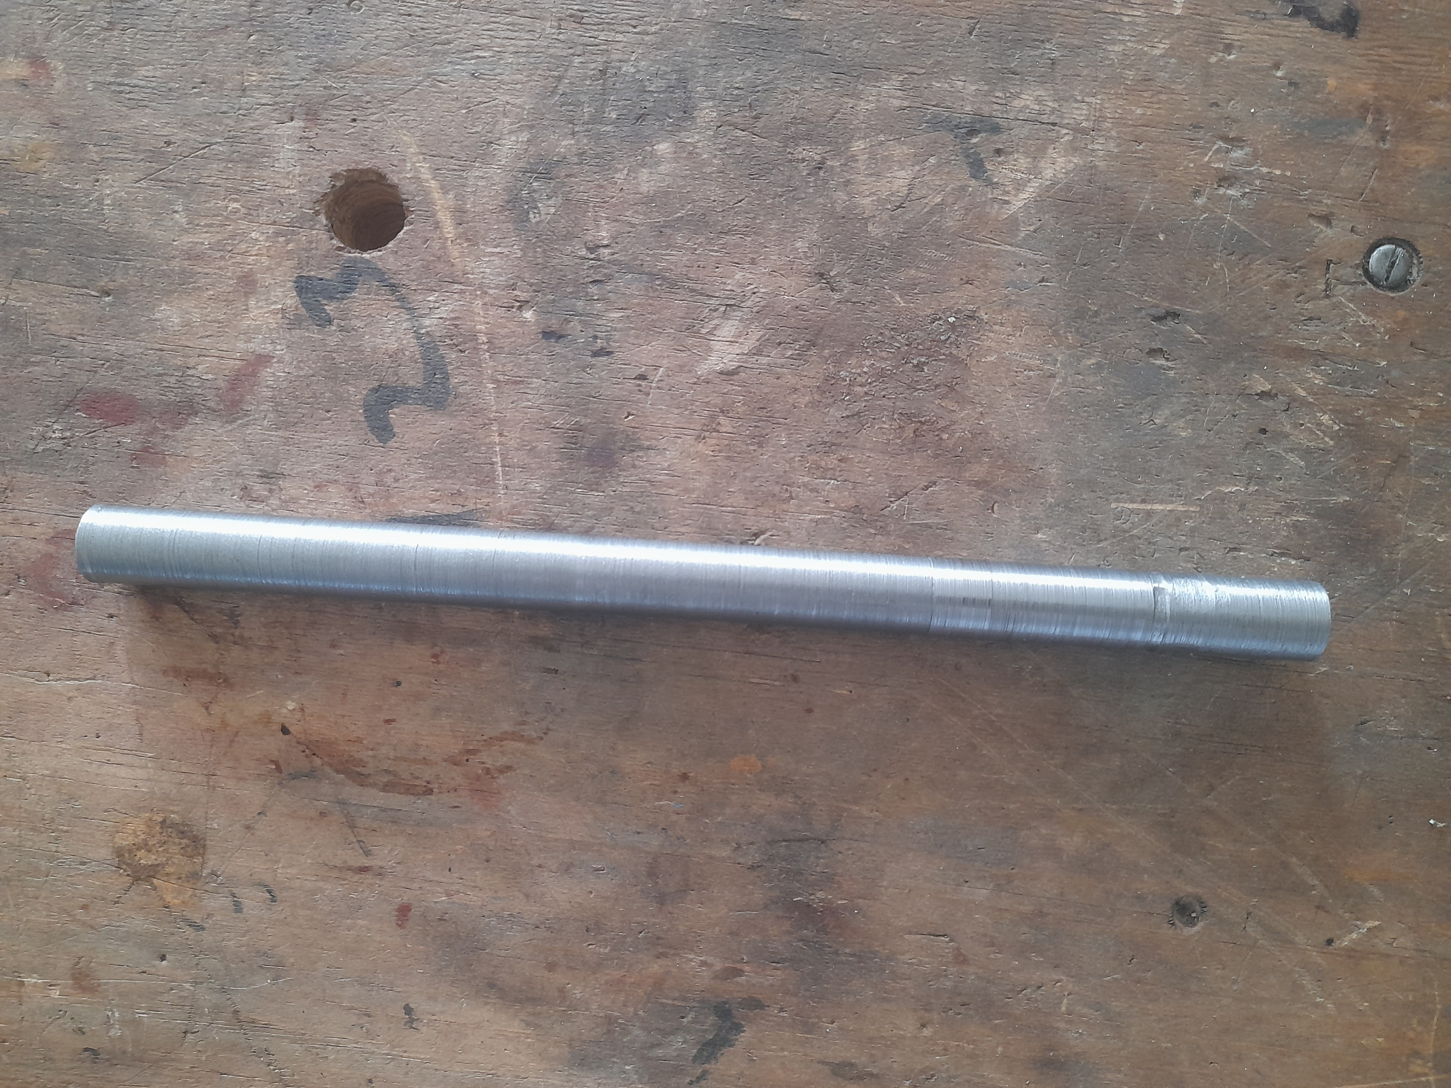
Machining of the casting Core rods#140
One core rod was
Machined
D = 16.9mm

Slide 7
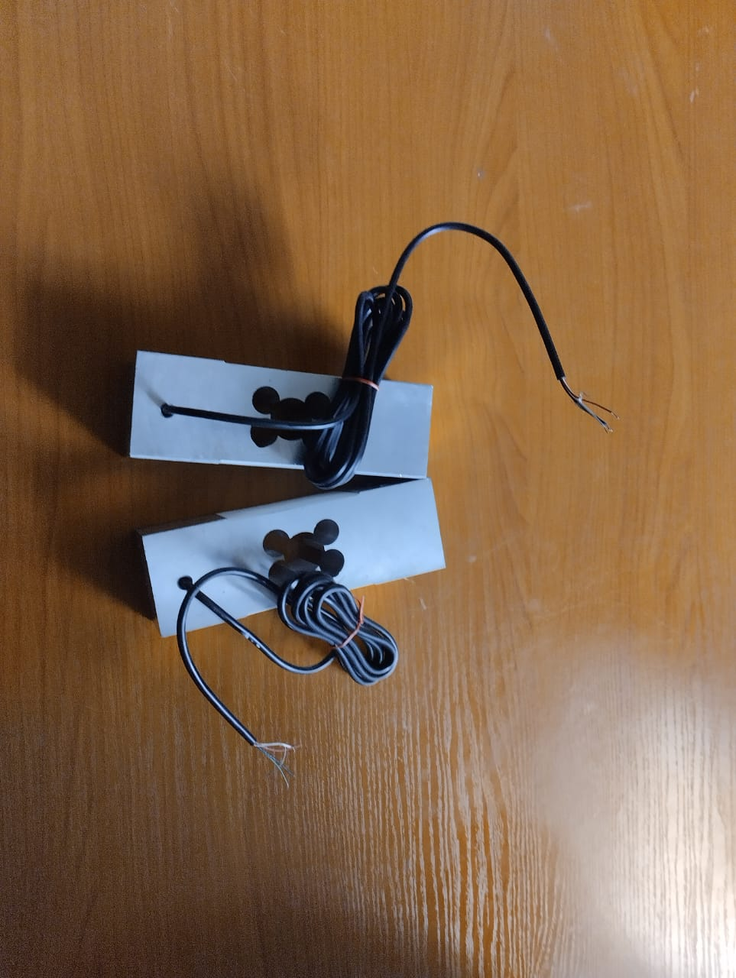
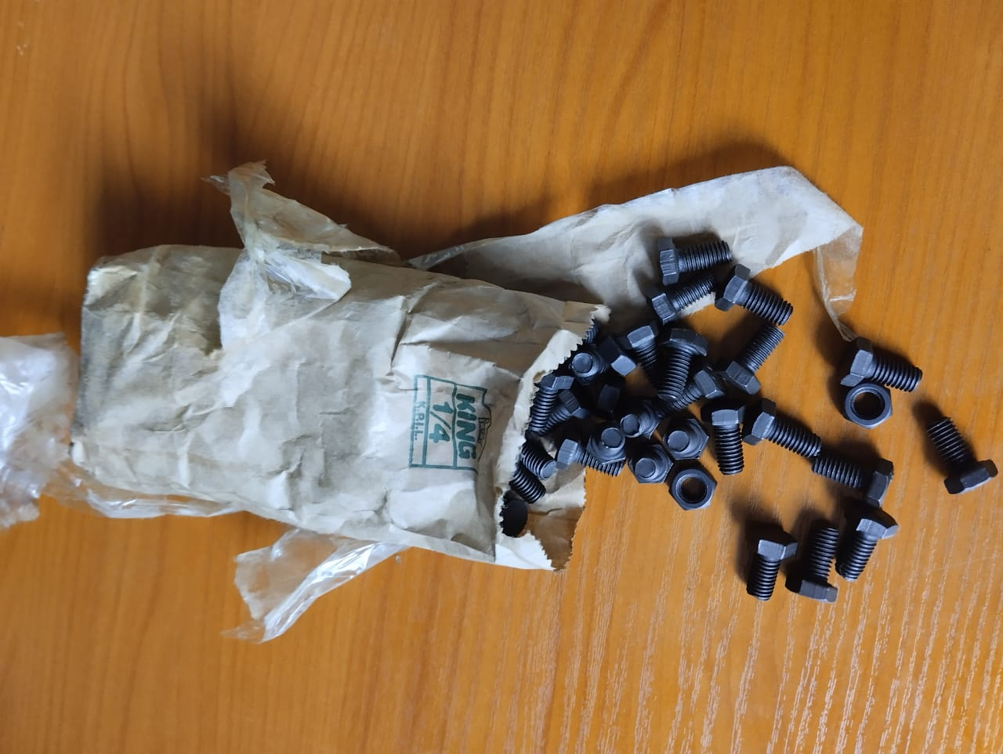
Purchase of Materials #115
2 Loadcells (800kgf)
100 Bolts and nuts(M8*16)

Slide 8
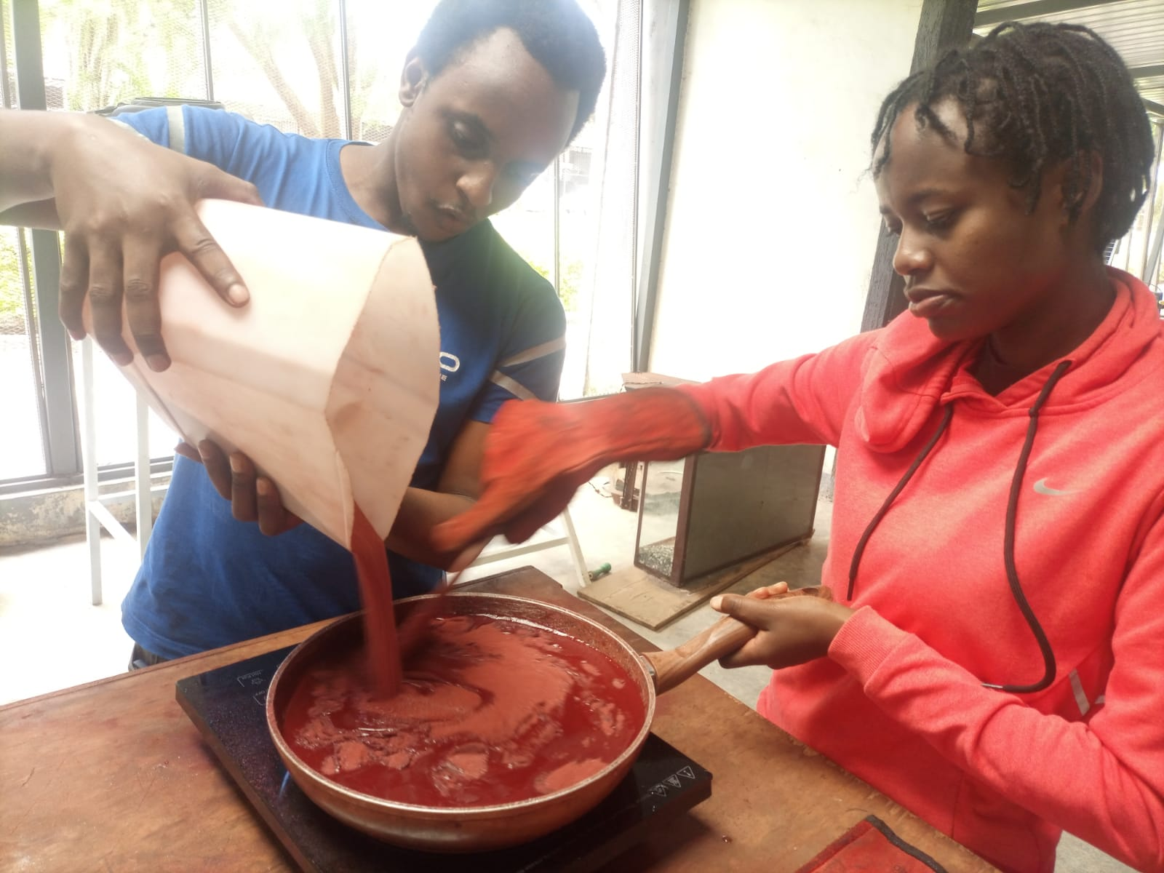
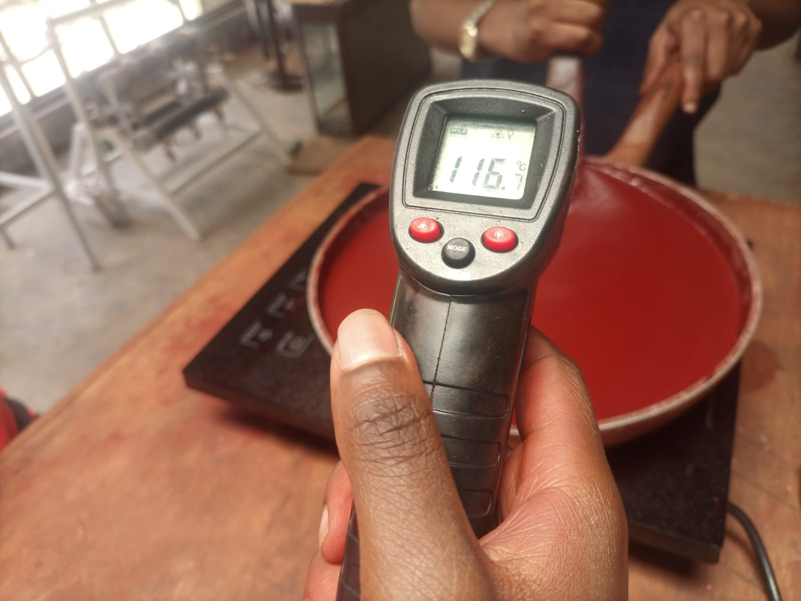
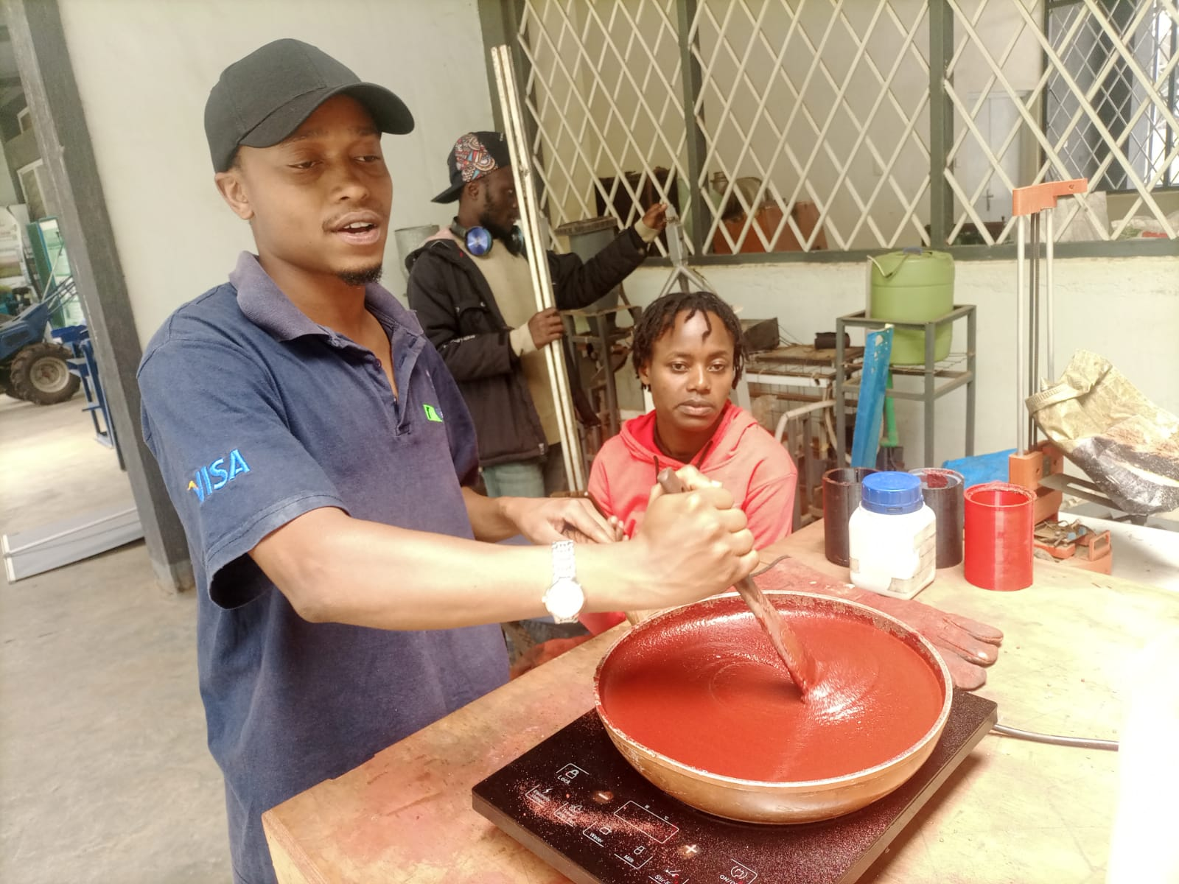
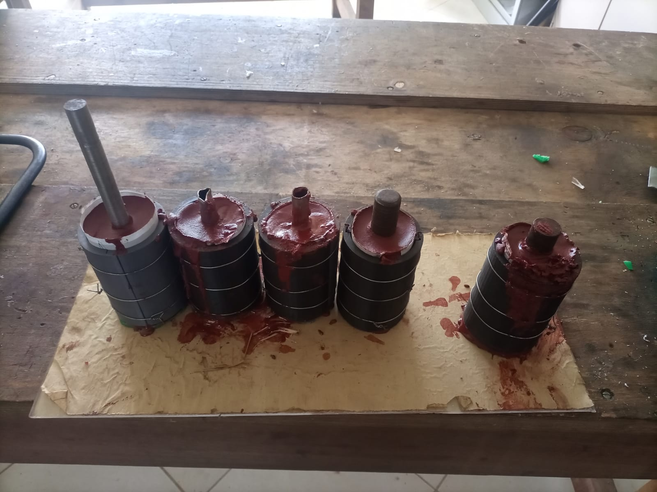
COOKING OF GRAINS.#83
INGREDIENTS
Potassium Nitrate:1977g
Sorbitol: 1521g
Iron III oxide: 30g
5 more grains were cooked

Slide 9
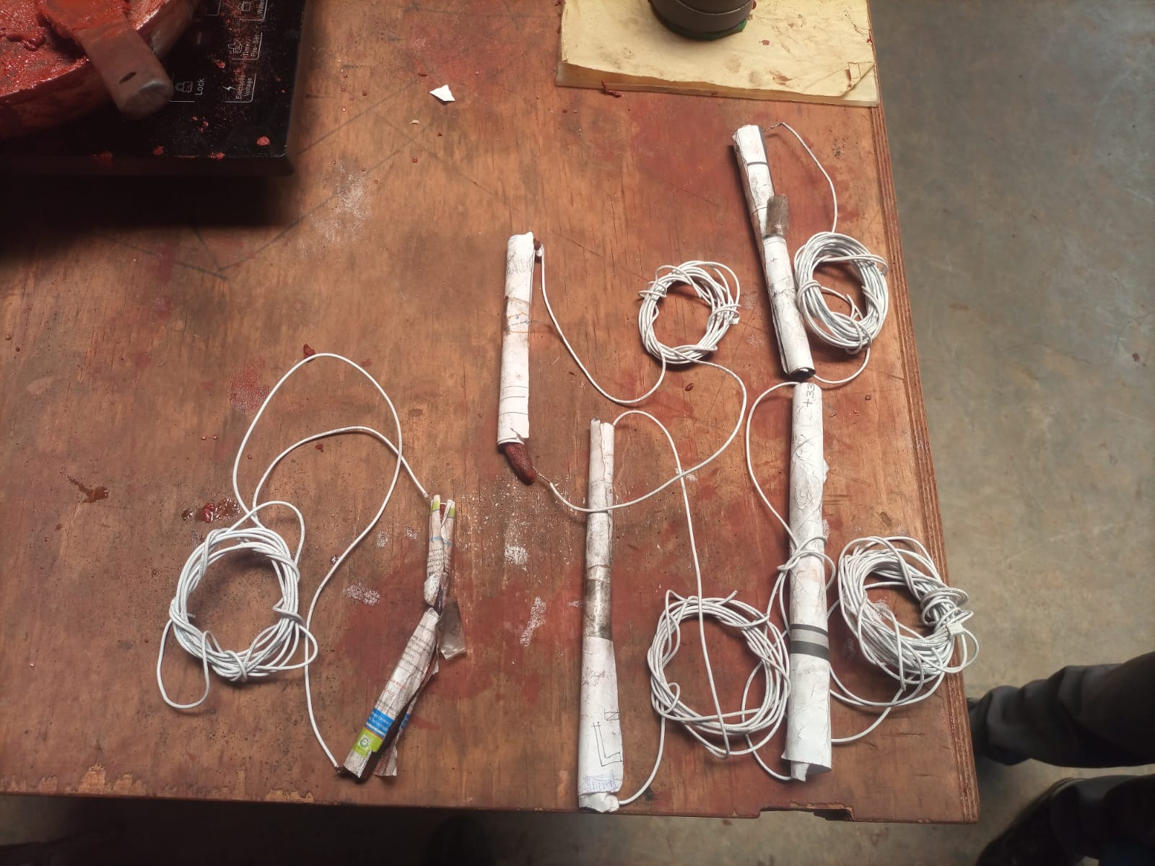
Making ignitors.#59
We made 5
More ignitors.

Slide 10
CHALLENGES
 | CHALLENGES
1 | Lathe’s tool post was wobbling thus imperfect machining
2 | Boring tool was not repaired

Slide 11
NEXT WEEKS TASKS
NO. | TASK
1 | Machining of more motor casings. #131
2 | Machining of more casting rods. #140
3 | Cooking of more grains. #83
4. | Test stand repair. #110
5. | Carry out fifth Static test. #141
6 | Work on the Journal publication of the Solid team.
7 | Loadcell calibration. #82

Slide 12
THANK YOU

